Slide 1
Data Structures & Algorithms
Part # 1: Overview & Review
Course Information
Course Title : Data Structures And Algorithms
Course Number : 0602211
Prerequisite : Discrete Math (0601203)+ OO 1+3 (Java)(0602204))
Instructor :Dr. Ali Al-Ibrahim
Coordinator: Dr. Ali Al-Ibrahim
Office Location :IT collage
Office Phone :2363
Office Hours :
Sunday, Tuesday, Thursday ( 10-11 am ), Monday, Wednesday ( 11: 12.30 )
E-mail :ali.alibrahim@wise.edu.jo
Dr.Ali AL-Ibrahim / wise/IT

Slide 2
Data Structures & Algorithms
Part # 1:
Overview & Review
Dr. Ali Al-Ibrahim
Dr.Ali AL-Ibrahim / wise/IT

Slide 3
Grading/Evaluation
Number | Course Assessment Tools | Percent
1 | First term | 20
2 | Second term | 20
3 | Class work | 10
4 | Final | 50
 | Total | 100
Dr.Ali AL-Ibrahim / wise/IT

Slide 4
Readings/references
Text Book:
  Data Structures & Algorithms in JAVA (4th Edition), by M. Goodrich & R. Tamassia, John Wiley & Sons, inc., 2006.
Additional Readings:
  Data Structures and Problem Solving with JAVA (3rd Edition), by Mark Allen Weiss, Addison Wesley, 2006.
  Lecture slides and handouts
Dr.Ali AL-Ibrahim / wise/IT

Slide 5
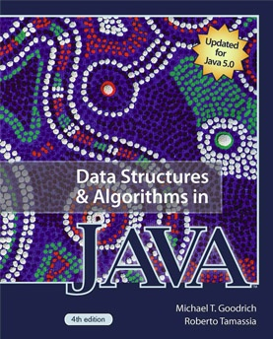
Text Book: M. T. Goodrich and R. Tamassia, "Data Structures and Algorithms in Java," 4th edition, 2006, Wiley & Sons, Inc., ISBN 978-0471738848.

Slide 6
Course objectives
Be familiar with problem solving
Be able to develop (and implement) algorithms
Be able to trace algorithms
Be able to select appropriate data structures and algorithms for given problems
Dr.Ali AL-Ibrahim / wise/IT

Slide 7
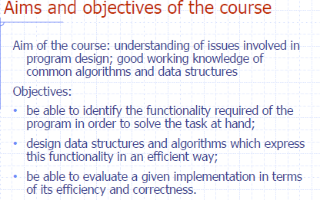

Slide 8
Course Outline
Fundamentals of data structures and algorithms
Static and dynamic data structures
Basic searching and sorting algorithms
Recursion
Abstract data types
Stacks and queues
Trees
Dr.Ali AL-Ibrahim / wise/IT

Slide 9
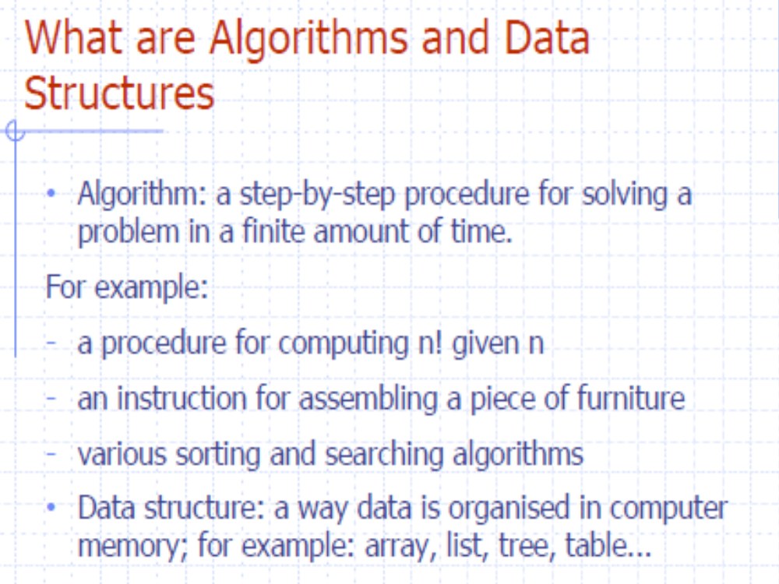

Slide 10
Basic Definitions
Data Structures:
A data structure is a systematic way of organizing and accessing data. Or, It’s the logical relationship between data elements.
Types of Data Structures:
- Linear D.S., such as arrays, stacks, queues.
- Non-linear D.S., such as tree.
Arrays:
An array is a numbered (indexed) collection of variables, all of the same type.

Slide 11
Storage Structure:
It is the physical (actual) representation of data elements in storage (memory).
Types of Storage Structures:
1- Sequential S.S.
(Suitable for storage of static D.S. such as arrays)
2- Linked S.S.
(Suitable for storage of dynamic D.S.)

Slide 12
Object Oriented Approach
One of the main ideas of the object-oriented approach is that: data should be presented as being encapsulated with methods (functions) that access and modify data.

Slide 13
ADT (Abstract Data Type):
It is a mathematical model of a data structure that specifies the following:
- the Type of data stored,
- the Operations performed (supported) on them, and
- the Types of Parameters of these operations.
An ADT is modeled in Java by a class.
Abstraction:
An ADT specifies what each operation does, but not how it does it.

Slide 14
Classes:
A class defines the data being stored and operations supported by the objects.
Objects:
An object is an instance of the class.
Objects in Java: store data and provide methods for accessing and modifying this data.
Interfaces:
An interface is simply a list of method declarations, where each method has an empty body.
Unlike an interface, classes specify how the operations are performed in the body of each method.

Slide 15
Algorithm
An algorithm is a step-by-step procedure for performing some task in a finite amount of time.
Pseudo Code
An algorithm is written (expressed) in a mixture of Natural languages and High-level programming languages, this is called pseudo code.
Program
A program is the implementation (translation) of an algorithm in some high-level programming language.

Slide 16
What is data?
Data
  A collection of facts from which conclusion may be drawn
  e.g. Data: Temperature 35°C; Conclusion: It is hot.
Types of data
  Textual: For example, your name (Muhammad)
  Numeric: For example, your ID (090254)
  Audio: For example, your voice
  Video: For example, your voice and picture
  (...)
Dr.Ali AL-Ibrahim / wise/IT

Slide 17
What is data structure?
A particular way of storing and organizing data in a computer so that it can be used efficiently and effectively.
Data structure is the logical or mathematical model of a particular organization of data.
A group of data elements grouped together under one name.
  For example, an array of integers
Dr.Ali AL-Ibrahim / wise/IT

Slide 18
Types of data structures
Array
Linked List
Queue
Stack
Tree
There are many, but we named a few. We’ll learn these data structures in great detail!
Dr.Ali AL-Ibrahim / wise/IT

Slide 19
The Need for Data Structures
Goal: to organize data
Criteria: to facilitate efficient
  storage of data
  retrieval of data
  manipulation of data
Design Issue:
  select and design appropriate data types
  (This is the main motivation to learn and understand data structures)
Dr.Ali AL-Ibrahim / wise/IT

Slide 20
Data Structure Operations
(Demonstrate using class room example!)
Traversing
  Accessing each data element exactly once so that certain items in the data may be processed
Searching
  Finding the location of the data element (key) in the structure
Insertion
  Adding a new data element to the structure
Dr.Ali AL-Ibrahim / wise/IT

Slide 21
Data Structure Operations (cont.)
Deletion
  Removing a data element from the structure
Sorting
  Arrange the data elements in a logical order (ascending/descending)
Merging
  Combining data elements from two or more data structures into one
Dr.Ali AL-Ibrahim / wise/IT

Slide 22
What is algorithm?
A finite set of instructions which accomplish منجز a particular task
A method or process to solve a problem
Transforms input of a problem to output
Algorithm = Input + Process + Output
Algorithm development is an art – it needs practice, practice and only practice!
Dr.Ali AL-Ibrahim / wise/IT

Slide 23
What is a good algorithm?
It must be correct
It must be finite (in terms of time and size)
It must terminate
It must be unambiguous ليس غامض
  Which step is next?
It must be space and time efficient
A program is an instance مرحلة of an algorithm, written in some specific programming language
Dr.Ali AL-Ibrahim / wise/IT

Slide 24
A simple algorithm
Problem: Find maximum of a, b, c
Algorithm
  Input = a, b, c
  Output = max
  Process
    Let max = a
    If b > max then
      max = b
    If c > max then
      max = c
    Display max
Order is very important!!!
Dr.Ali AL-Ibrahim / wise/IT

Slide 25
Algorithm development: Basics
Clearly identify:
    what output is required?
    what is the input?
    What steps are required to transform input into output
      The most crucial bit
      Needs problem solving skills
      A problem can be solved in many different ways
      Which solution, amongst the different possible solutions is optimal?
Dr.Ali AL-Ibrahim / wise/IT

Slide 26
How to express an algorithm?
A sequence of steps to solve a problem
We need a way to express يصور , يعبر عن this sequence of steps
  Natural language (NL) is an obvious واضحchoice, but not a good choice. Why?
    NLs are notoriously ambiguous (unclear)
  Programming language (PL) is another choice, but again not a good choice. Why?
    Algorithm should be PL independent
  We need some balance
    We need PL independence
    We need clarity
    Pseudo-code provides the right balance
Dr.Ali AL-Ibrahim / wise/IT

Slide 27
What is pseudo-code?
Pseudo-code is a short hand way of describing a computer program
Rather than using the specific syntax of a computer language, more general wording is used
It is a mixture of NL and PL expressions, in a systematic way
Using pseudo-code, it is easier for a non-programmer to understand the general workings of the program
Dr.Ali AL-Ibrahim / wise/IT

Slide 28
Pseudo-code: general guidelines
Use PLs construct that are consistent ثابت , متناسق with modern high level languages, e.g. C++, Java, ...
Use appropriate comments for clarity
Be simple and precise دقيق
Dr.Ali AL-Ibrahim / wise/IT

Slide 29
Components of Pseudo-code
Expressions
  Standard mathematical symbols are used
    Left arrow sign (←) as the assignment operator in assignment statements (equivalent to the = operator in Java)
    Equal sign (=) as the equality relation in Boolean expressions (equivalent to the "= =" relation in Java)
    For example
    Sum ← 0
    Sum ← Sum + 5
    What is the final value of sum?
Dr.Ali AL-Ibrahim / wise/IT

Slide 30
Components of Pseudo-code (cont.)
Decision structures (if-then-else logic)
  if condition then true-actions [else false-actions]
  We use indentation to indicate what actions should be included in the true-actions and false-actions
  For example
    if marks > 50 then
    print “Congratulation, you are passed!”
    else
    print “Sorry, you are failed!”
  end if
  What will be the output if marks are equal to 75?
Dr.Ali AL-Ibrahim / wise/IT

Slide 31
Components of Pseudo-code (cont.)
Loops (Repetition)
  Pre-condition loops
    While loops
      while condition do actions
      We use indentationفجوة to indicate what actions should be included in the loop actions
      For example
    while counter < 5 do
    print “Welcome to WISE”
    counter ← counter + 1
    end while
  What will be the output if counter is initialised to 0, 7?
Dr.Ali AL-Ibrahim / wise/IT

Slide 32
Components of Pseudo-code (cont.)
Loops (Repetition)
  Pre-condition loops
    For loops
      for variable-increment-definition do actions
      For example
    for counter ← 0; counter < 5; counter ← counter + 2 do
    print “Welcome to WISE”
    end for
  What will be the output?
Dr.Ali AL-Ibrahim / wise/IT

Slide 33
Components of Pseudo-code (cont.)
Loops (Repetition)
  Post-condition loops
    Do loops
      do actions while condition
      For example
    do
    print “Welcome to WISE”
    counter ← counter + 1
    while counter < 5
    What will be the output, if counter was initialised to 10?
  The body of a post-condition loop must execute at least once
Dr.Ali AL-Ibrahim / wise/IT

Slide 34
Components of Pseudo-code (cont.)
Method declarations
  Return_type method_name (parameter_list) method_body
  For example
    integer sum ( integer num1, integer num2)
    start
    result ← num1 + num2
    end
Method calls
  object.method (args)
  For example
  mycalculator.sum(num1, num2)
Dr.Ali AL-Ibrahim / wise/IT

Slide 35
Components of Pseudo-code (cont.)
Method returns
  return value
  For example
    integer sum ( integer num1, integer num2)
    start
    result ← num1 + num2
    return result
    end
Dr.Ali AL-Ibrahim / wise/IT

Slide 36
Components of Pseudo-code (cont.)
Comments
  /* Multiple line comments go here. */
  // Single line comments go here
  Some people prefer braces {}, for comments
Arrays
  A[i] represents the ith cell in the array A.
  The cells of an n-celled array A are indexed from A[0] to A[n − 1] (consistent with Java).
Dr.Ali AL-Ibrahim / wise/IT

Slide 37
Algorithm Design: Practice
Example 1: Determining even/odd number
  A number divisible by 2 is considered an even number, while a number which is not divisible by 2 is considered an odd number. Write pseudo-code to display first N odd/even numbers.
Example 2: Computing Weekly Wages
  Gross pay depends on the pay rate and the number of hours worked per week. However, if you work more than 40 hours, you get paid time-and-a-half for all hours worked over 40. Write the pseudo-code to compute gross pay given pay rate and hours worked
Dr.Ali AL-Ibrahim / wise/IT

Slide 38
Even/ Odd Numbers
Input range
for num←0; num<=range; num←num+1 do
if num % 2 = 0 then
print num is even
else
print num is odd
endif
endfor
Dr.Ali AL-Ibrahim / wise/IT

Slide 39
Computing weekly wages
Input hours_worked, pay_rate
if hours_worked <= 40 then
gross_pay ← pay_rate x hours_worked
else
basic_pay ← pay_rate x 40
over_time ← hours_worked – 40
over_time_pay ← 1.5 x pay_rate x over_time
gross_pay ← basic_pay + over_time_pay
endfor
print gross_pay
Dr.Ali AL-Ibrahim / wise/IT

Slide 40
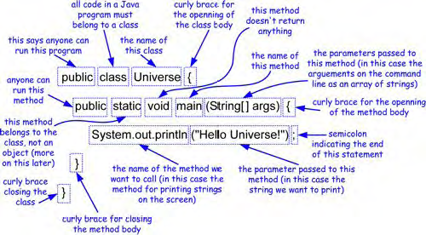
Dr.Ali AL-Ibrahim / wise/IT

Slide 41
Homework
Write an algorithm to find the largest of a set of numbers. You do not know the number of numbers.
Write an algorithm in pseudocode that finds the average of (n) numbers.
      For example numbers are [4,5,14,20,3,6]
Dr.Ali AL-Ibrahim / wise/IT

Slide 42
QZ # !
Q1 :If Range = 5 Trace the following Algorithm:
Input range
for num←0; num<=range; num←num+1 do
if num % 2 = 0 then
print num is even
else
print num is odd
endif
Endfor.
Q2 : Define the following :
Data structure
Algorithm
ADT
Pseudo-code
Dr.Ali AL-Ibrahim / wise/IT

Slide 43
QZb # !
Q1 :If a=-1,b=-6 c=-10 the following Algorithm:
Algorithm
  Input = a, b, c
  Output = max
  Process
    Let max = a
    If b > max then
      max = b
    If c > max then
      max = c
    Display max
Q2 : answer the following :
Types of Data Structures + example :
Dr.Ali AL-Ibrahim / wise/IT

